Slide 1
Elk grove village youth baseball
2014
Skills & Concepts for ages 6-8

Slide 2
Common purpose
Create a positive experience for the children.
Create a desire for the children to want to play again the following year.
Dr. Darrell Burnett, Certified Sports Psychologist specializing in Youth Sports and member of the Little League International Board of Directors
“Since Tee Ball is the ENTRY level of the youth sports process, what kids experience will have quite an impact on whether they want to continue in youth sports process. The issue is this that we want kids' entry level experience to be pleasant. What's pleasant to kids? Just watch them. FUN and ACTION are the keys. And, even in the early stages, if they learn some skills it will add to the fun.”

Slide 3
key concepts
Base running
Names of bases
How to circle bases
Understanding where to run after a hit is made (hitters and runners)
Running through 1st base
The concept of a “force” out

Slide 4
key concepts
Defense
Names of defensive positions
Knowing where to stand to field a position
Understanding the goal of getting an out
Catching a ball
Holding a glove
Moving glove to the ball
Throwing a ball
Grip
Proper throwing technique
The concept of tagging a player out
The concept of a “force” out
Recognition that there are 3 outs per inning
Covering a base of responsibility

Slide 5
key concepts
Offense
Understanding the goal of getting a hit (safe vs. out)
How to properly hold a bat
Proper hitting stance
The technique of a “short compact swing”
Understanding contact points
Pull, Middle, Oppo
Understanding hitting terminology
Ground balls, fly balls, line drives
Single, double, triple, home run, grand slam
Understanding the concept of an inning
Understanding there are 3 strikes and 4 balls in an at bat”

Slide 6
Practice topics
Practice Topics
Warm ups
Pre game/practice talk
Playing catch
Fielding ground balls
Hitting
Covering bases on defense
Converting a force out at 2nd & 3rd base
Pitching & Catching
Post game/practice talk

Slide 7
Practice overview
Equipment List
Hitting Tee
Hitting Net
Bucket of balls
Catchers gear
Helmets
Bats
2 Coaches
Topic | Time | Type | # of kids
Warm Ups | 10 mins | Entire Team | All
Pre Talk | 5 mins | Entire Team | All
Throwing/Catching | 25 mins | 3 groups | 3-4
Fielding grounders | 25 mins | 3 groups | 3-4
Hitting | 25 mins | 3 groups | 3-4
Manager Choice | 25 mins | Manager Choice | Manager Choice
Post Talk | 5 mins | Entire Team | All

Slide 8
Practice tips
Coaches should arrive to the field and be ready to go 10-15 minutes before practice. Time is of the essence. Be prepared for practice.
Teams play the way they practice. Intensity should be kept at game speed throughout practice. Emphasize hustle on & off the field.
Practices should be conducted with a sense of urgency. Spend the first few practices teaching your players how practices are going to be structured and what is expected of them. Early in the season this will have to reinforced often.
Try to keep practices fun and challenging.
Have a short talk with your team before and after practices
and games.

Slide 9
Practice - Warm ups (10 minutes – Entire team)
Key Point - Players should be part of a routine before practice or a game
Run – Jog two laps around the bases
Basic Plyometrics
Side shuffles – Run sliding heel to heel
High Knees – Run with knees coming up high to chest
Butt kickers – Bring heels into butt with every step
Backward run – run backwards
Power skips – Skip with power movement of arms
Straight sprints – 70’ sprint

Slide 10
Practice – throwing and catching (30 minutes)
Key Point – Playing catch is the single most important defensive drill we can perform. Focus on the fundamental throwing and catching techniques. Each player should throw and catch 50+ balls every practice. Repetition is the key!
Pair up kids of about equal skill level
Break technique
Positions 1-2-3
“Bow & Arrow” toss then regular catch
Start about 15 feet apart and move back 5’ after every 10 throws
Tips: Younger players are not always ready to play catch. For those kids, have them stand 15-10 feet from the fence and practice throwing into the fence. To practice their catching skills, stand about 10 feet away from them and toss the ball to them to try and catch. Throw 10 balls to the right, 10 to the left, 10 above their waist, and 10 below the waist.

Slide 11
Practice – Throwing technique
Throwing
Grip – Use a 4 seam grip. (Fingers across the laces)
Hand Breaks – This movement should be quick, smooth, and rounded.
Start with the hands in a praying position with thumbs up
Break hands out and turn them over to thumbs down position
Think of this as “unzipping” a coat
Position 1-2-3
Position 1 – Stand in the “stretch” position, hands together & up
Position 2 – Stand on throwing leg while lifting opposite leg out and up in front of body. (high knee and foot close to ground)
Position 3 – Break hands, stride forward, & bring arm through for the throw. Finish balanced! Shoulder angles usually dictate the trajectory of the throw. Emphasize to kids to drive their body as they bring the arm through.
4 seam grip
Tips: Balance is baseball is HUGE! You cannot over emphasize this point. Encourage the kids to go home and practice standing in position 2 until they can do this comfortably for extended periods of time.

Slide 12
Practice – throwing images
Hand Break
Position 1
Position 2
→Lead w/elbow
Position 3

Slide 13
Practice – Catching technique
Catching
There are 4 main glove positions. The glove should always be receiving the ball in one of these 4 positions depending on where it is.
Glove up – Thumb right (for right handers)
Glove down – Thumb left
Glove right – Thumb down
Glove left – Thumb up
Emphasize moving body to the ball to get in front of a catch whenever possible.
Use 2 hands on every catch.
Teach kids to assume a bad throw is coming. This will get them ready and make catching good catches that much easier.
Tips: Breaking in a glove properly is extremely important. Help kids understand how to “work” their gloves as they are playing catch.

Slide 14
Practice – FIELDING Grounders (30 MINUTES)
Key Point – Each player should be able to take 50+ grounders per practice. You don’t need to hit the grounders. Stand 15-20 feet away and toss grounders. Repetition is the key!
Fielding Technique
Chest up (not down), see what’s going on in front of you
Charge toward the ball
Feet spread out with hands out in front (triangle position, keep left foot out front for right handed throwers)
Bare hand over top of glove when right in front of you
Always catch the ball out in front of you (for back hand or any position)
Pull hands to middle of the body after catching the ball (this drives your momentum towards 1st base)
Get feet set underneath and throw to 1st base
Follow your throw to 1st base
Tips: Teach kids to get their gloves under the ball. Practice throwing balls to the middle, to the backhand, & to the forehand sides. To save time have you can have the kids drop the ball to a bucket after they catch it.

Slide 15
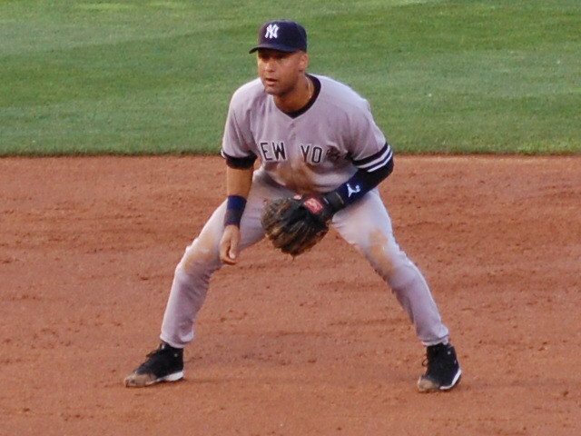
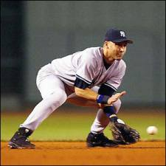
Practice – FIELDING images
Ready Position
Fielding Position

Slide 16
Practice – hitting (30 minutes)
Key Point – Each player should be able to take 50+ swings per practice between Tee drills, flip drills, soft toss, & regular pitching. Repetition is the key!
Groups of 4
1 player – Tee drills
Regular swings, 1 arm swings
2 players – Flip drills
Front flips, rear flips
1 player – Front pitching
Soft toss, regular pitching
Tips:
Constantly talk hitting with your players. Teach them to be aggressive hitters. Assume swing on every pitch and then take when it’s a bad pitch.

Slide 17
Practice – hitting technique
Stance – Feet should be lined up straight. (Draw a line in the dirt if necessary to emphasize this point)
Balance – Hitters should be balanced (strong athletic stance) both before and after the swing. (Have players hold their position after they complete the swing to emphasize this)
Hands – Short swings
During drills - Hands should be close to the chest with bat on shoulder.
Move hands as if your pulling a rope from over your shoulder.
During BP - Hands should move back or back and up but not back and down. (Bat should be moving at the ball at a slight down angle)
Swing - Short compact swings
We are not focusing on loading and striding yet
Head – Heads should stay still. (Should not be moving forward)

Slide 18
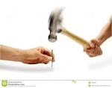
Practice – hitting contact points
Pull
Middle
Oppo
Pull
Short, Compact

Slide 19
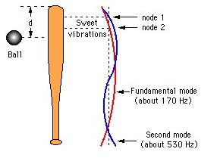
Practice – hitting “Sweet spot”
Batters know from experience that there is a sweet spot on the bat, about 17 cm from the end of the barrel, where the shock of the impact, felt by the hands, is reduced to such an extent that the batter is almost unaware of the collision.
At other impact points, the impact is usually felt as a sting or jarring of the hands and forearm, particularly if the impact occurs at a point well removed from the sweet spot.

Slide 20
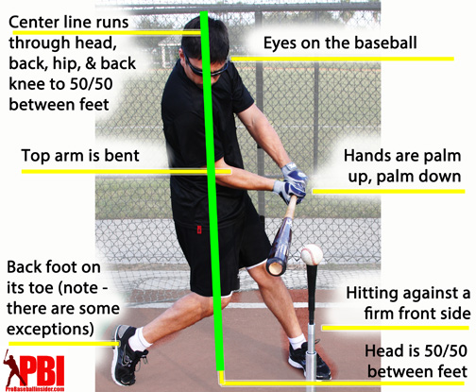
Practice – hitting mechanics

